Slide 1




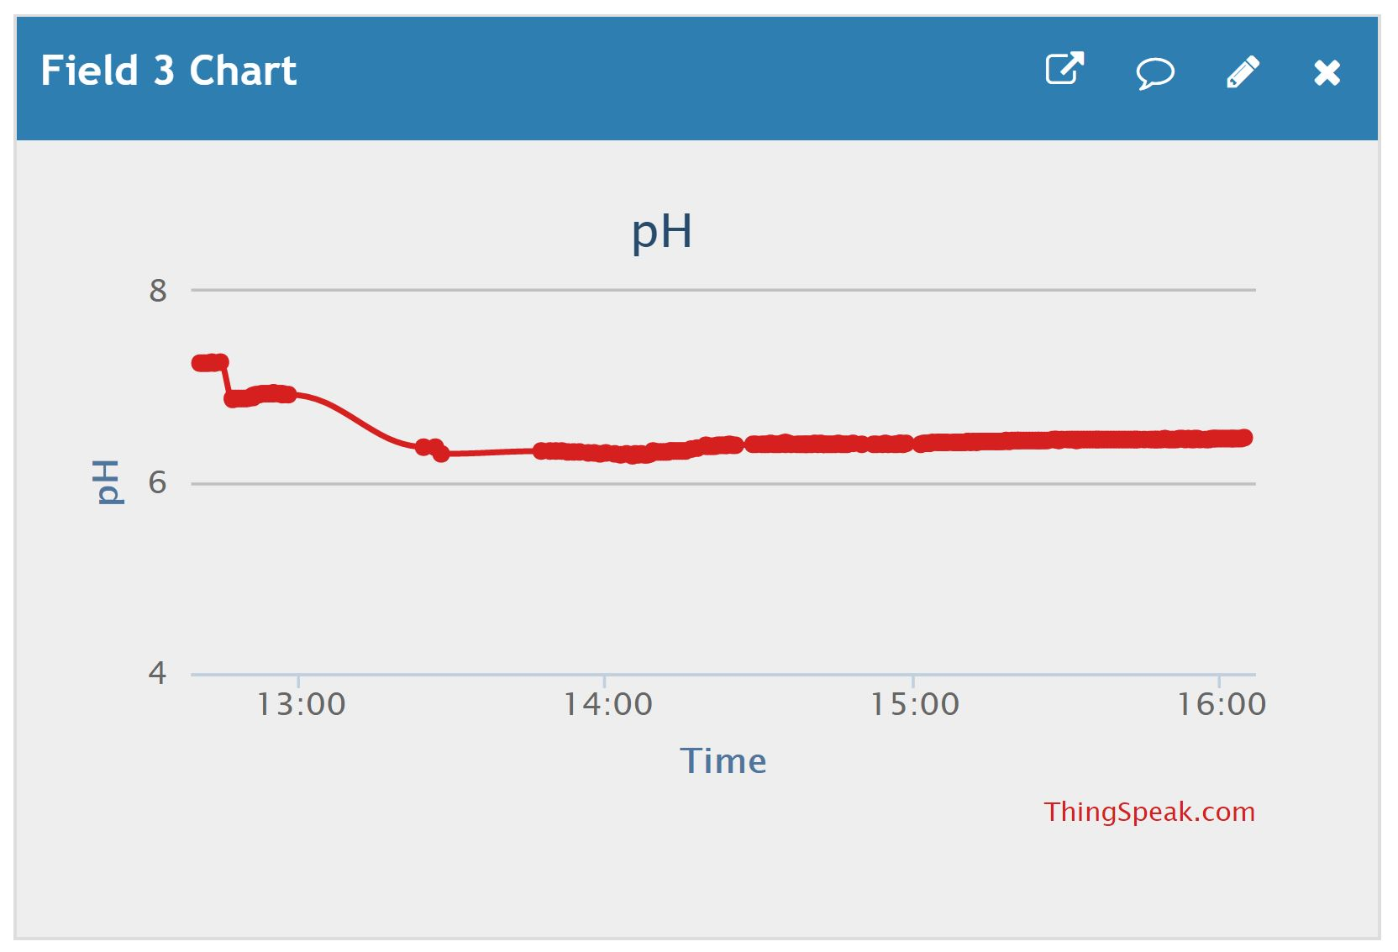
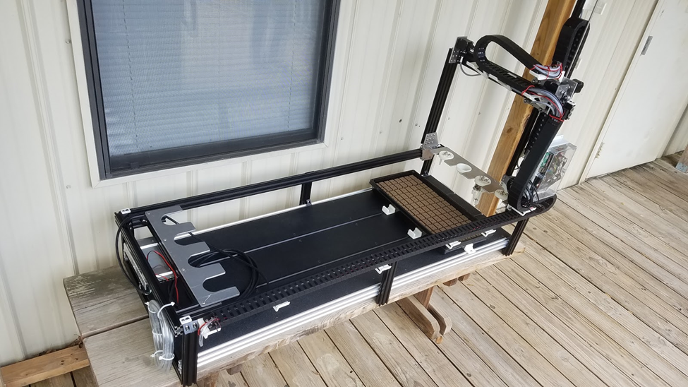
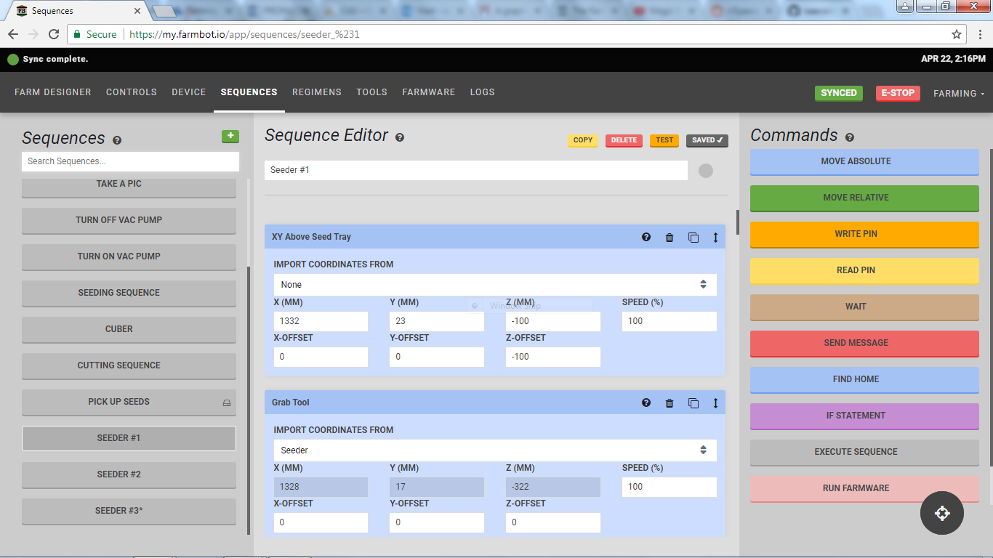
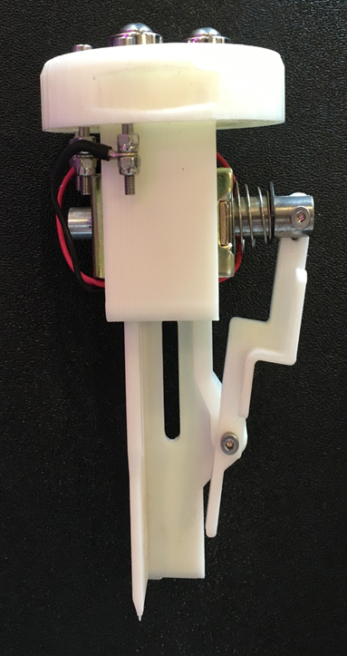
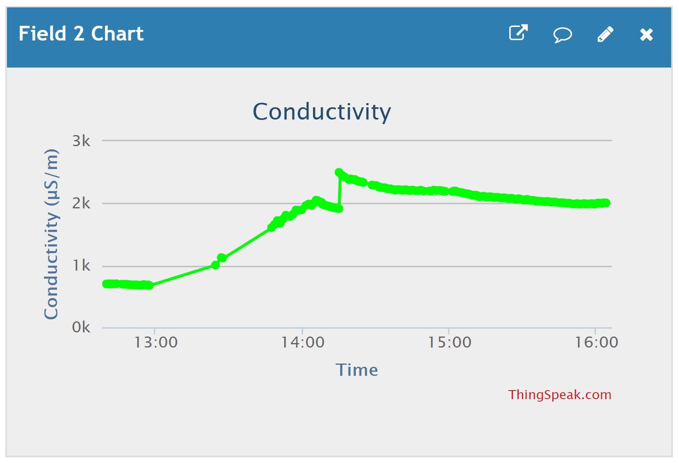
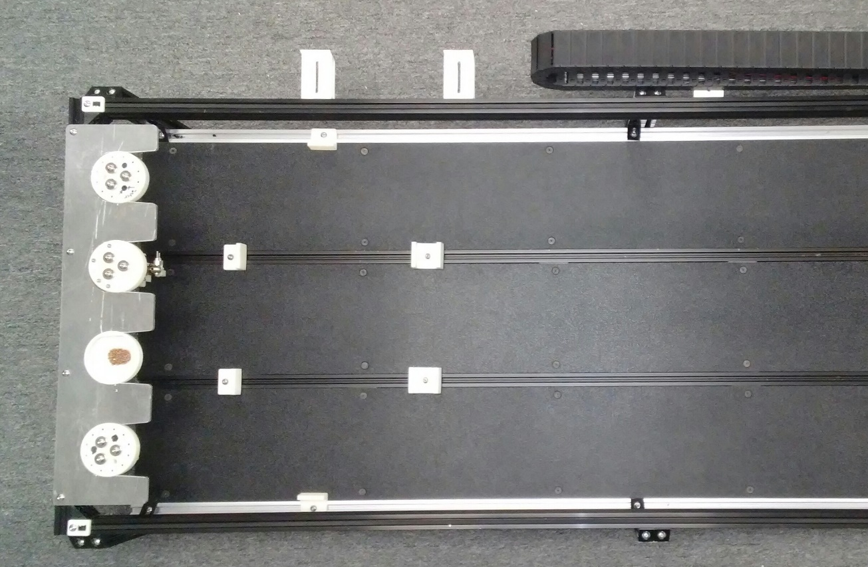
Automation and Control of Hydroponic Systems
Pete R. Ortega, Kurtis Alder, Shane Barnett, Isaac Olson, Elizabeth Rosseett, Jamal Rouse, Daniel Wrzesinski, Madeline Wrzesinski
San Antonio College, CIMA-LSAMP
ABSTRACT
METHODS
RESULTS
CHALLENGES
To achieve steady crop production and effective growth patterns of various types of plants, constant monitoring and adaptability is required of a hydroponic system. When researching alternative watering, lighting, or other variable practices on different varieties of plants, having an automated system that can ensure timely maintenance in a secure environment is imperative for accurate results. This project produced a remotely-controlled system that is also portable and easily transplanted into various enclosed environments, which can act to promote plant research world-wide and provide a reliable source of vegetation under climates unequipped for consistent plant growth. In situations where farmers are unable to continue production due to lack of assistance, an automated system would also be able to cover most labor-intensive tasks. This project augmented FarmBot techniques and technologies to Arduino and Raspberry Pi hardware. The finished system can plant seeds in a pre-specified location and individually propagate the seedlings.
System Design
Floor Design
Tool Design
Software Design
3D Printing
Part Design
System Testing
Figure 1. Completed San Antonio College FarmBot
Once the system was assembled, it was able to gather information from eight different sensors. The values of those readings were reported to the internet via wifi, and we were able to begin experiments on two of the parameters, pH and conductivity levels. After the system’s functionality was tested and verified, plants were added and the growth phase of the project can now begin.
Connectivity was a constant issue due to our Internet source requiring a login and Farmbot could only communicate on an open connection
3D Manufacturing was limited by the complexity of certain parts and a lack of consistent availability from the technicians and machines
Programming challenges arose once more advanced sequences were required due to the simple graphic user interface provided by Farmbot
Cutting various metal parts proved to be quite difficult and expensive due to the lack of appropriate machinery
FUTURE WORK
The natural next step in this project is to add plants for growth pattern testing. In order to decrease human involvement in the system, the following additions should be made:
Control air temperature, water temperature, light intensity, light color, carbon dioxide, nitrogen, and water level of reservoir.
Protect water reservoir from outer elements (seal water reservoir)
Install video surveillance system
Wrap entire enclosure
Install reliable fresh water access to water reservoir
BACKGROUND
As the human population continues to grow, it is necessary to begin considering ways to produce food that do not involve further land degradation, depletion of soil, and loss of biodiversity. The need for hydroponic gardening systems is emergent, and automating such systems in an affordable and neatly-packaged container small enough to fit in an average backyard increases the appeal to everyday people. Automated agriculture is a budding circle in the food production community. For example, Hands Free Hectare, a project based in the United Kingdom, is currently working on producing autonomous vehicles and drones that are able to maintain a fully automated farm. Just last September, in 2017, Hands Free Hectare was able to produce the first farm in the world to "successfully plant, tend, and harvest a crop without a single person ever setting foot in the field" (Feinfold, 2017). Automated sections of agricultural systems are becoming more common, but a fully automated process from seed to harvest with zero human interaction is a new and upcoming implementation of agricultural automation.
Figure 3. pH Graph during automation
When fresh tap water was added to the main reservoir, the system was turned on and tested for functionality. The graph in figure 3 shows how the program reduced the pH from 6.92 to 6.19. The program added 3 mL of pH DOWN solution to the water reservoir continuously each minute while the air pump mixed the solution thoroughly. This first process was completed in 10 minutes after adding a total of 30 mL to the solution.
ACKNOWLEDGEMENTS
Funding provided by the National Science Foundation CIMA LS-AMP grant (Award No. 1305001), The Alice Kleberg Reynolds Foundation. A special thanks to Pete R. Ortega, Steven Lewis, Amanda Lewis, and Dee Dixon for providing insight, leadership, and guidance. Thanks to San Antonio College and EcoCentro for allowing the means and facilities for this project. Thanks to the members of this Summer’s Hydroponic Solution team, and the members of the Effects of Three Light Treatments on Red and Green Lettuce team. Their advice was invaluable in recommendations for
REFERENCES
OBJECTIVES
Figure 4. Conductivity graph during automation test
Once the pH levels were within the necessary range, the program began to raise the conductivity level. 6 mL each of nutrient A and B were added every minute until the conductivity level reached 2000 μS/m. In this test, the conductivity level showed a spike once the water pump motor started sending the water through the system. This is possibly due to interference from the motor. The level re-stabilized itself after an hour.
Graphs of all sensor readings can be found on the ThingSpeak website at https://thingspeak.com/channels/298095
Develop a robot for remote planting, propagation, and relocation of seedlings to a growth stage area
Design the robot in a scalable fashion that would allow for additional enhancements to be made
Invetech. Forbio: Robotic Plant Propagation. http://www.invetech.com.au/portfolio/life-sciences/robotic-plant-propagation/
Gale, Fred. “America's Aging Farmers: Who Will Take Their Place?” United States Department of Agriculture: National Agricultural Library, USDA Economic Research Service, 1 Oct. 1993, naldc.nal.usda.gov/download/IND20388152/.
Feingold, Spencer. “Field of Machines: Researchers Grow Crop Using Only Automation.”CNN, Cable News Network, 8 Oct. 2017, www.cnn.com/2017/10/07/world/automated-farm-harvest-england/index.html.
Figure 2. Wiring Diagram

